Slide 1
The Battle of Neighborhoods
Capstone Project Pablo de la Fuente Aguilera
Week 1

Slide 2
Presentation of the Problem
Capstone Project Pablo de la Fuente Aguilera
We can suppose that we are thinking about opening a exotic restaurant in Manhattan, more specifically a Japanese or Asiatic one. This could be a good business opportunity but we need to carry out a market research in order to establish a long-term success.
To start with, we will analyse the existing restaurants of this category in Manhattan. And we will sort them by neighborhood, in order to identify the best possible location.
At the end, we will identify, based on a clustering, the best possible location in Manhattan.
Initial Presentation
The Battle of Neighborhoods
Week 1

Slide 3
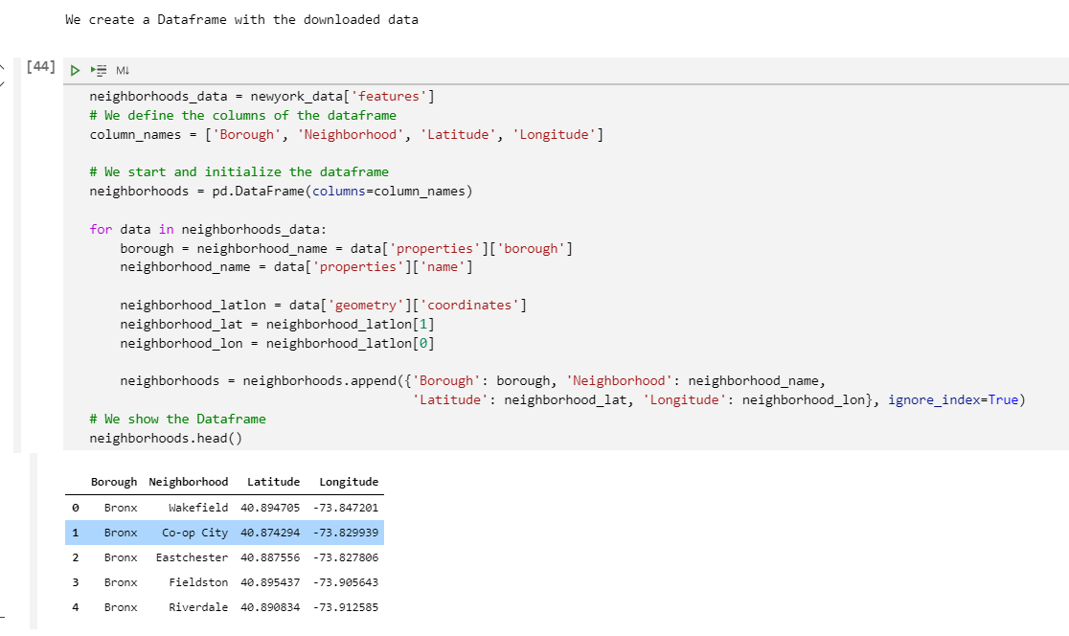
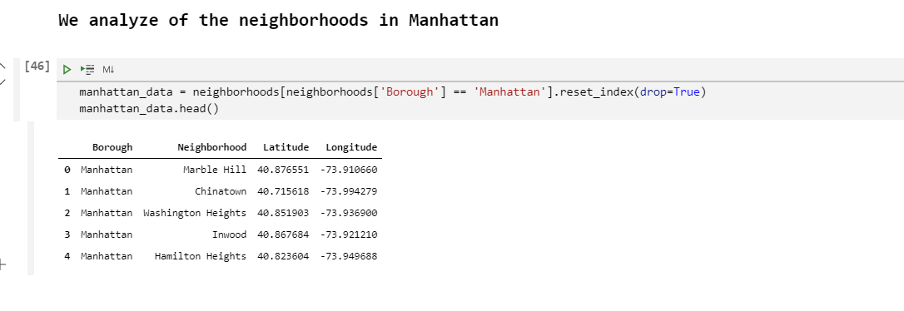
Presentation of the Problem
Capstone Project Pablo de la Fuente Aguilera
We take data from all Boroughs
And then concentrate on Manhattan
Analysis of the New York Perspective and concentrate the focus on Manhattan
The Battle of Neighborhoods
Week 1

Slide 4
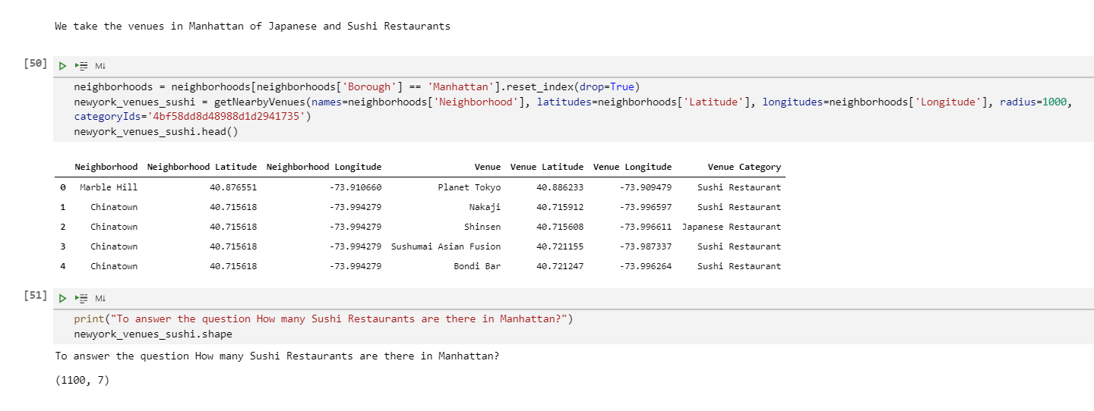
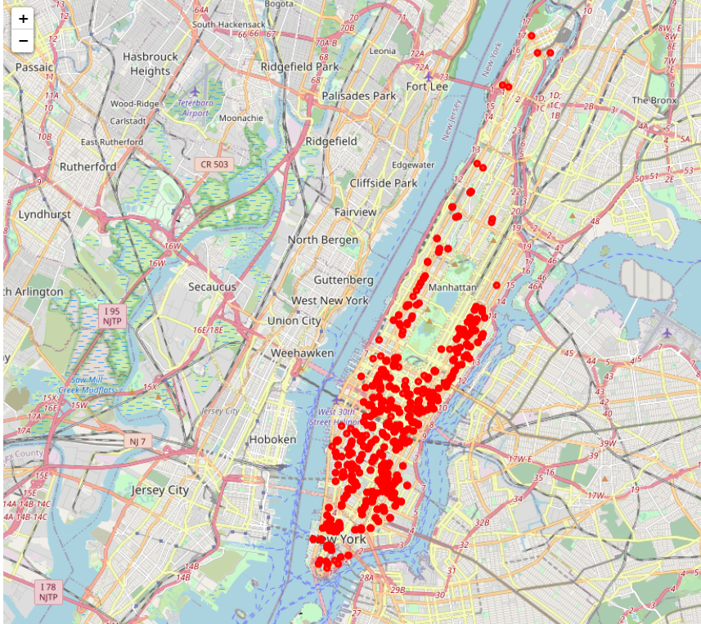
Presentation of the Problem
Capstone Project Pablo de la Fuente Aguilera
We take data from Foursquare about all the Venues in Manhattan, filtering by Category
And show them in a map
Analysis of the Venues in Manhattan
The Battle of Neighborhoods
Week 1

Slide 5
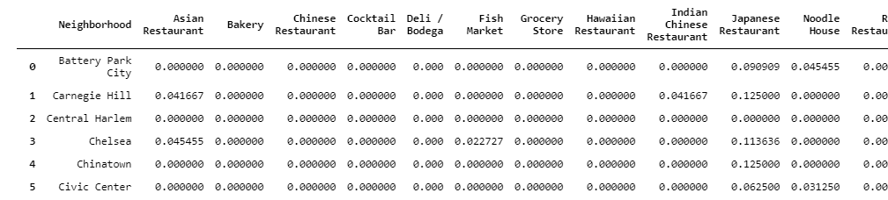
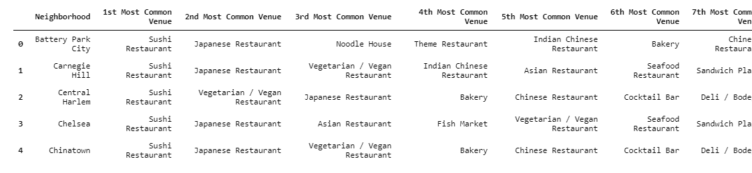
Presentation of the Problem
Capstone Project Pablo de la Fuente Aguilera
We analyze the different neighborhoods in Manhattan by frequencies, according to the venues
And the most common venues
Analysis of the Venues in Manhattan
The Battle of Neighborhoods
Week 1

Slide 6
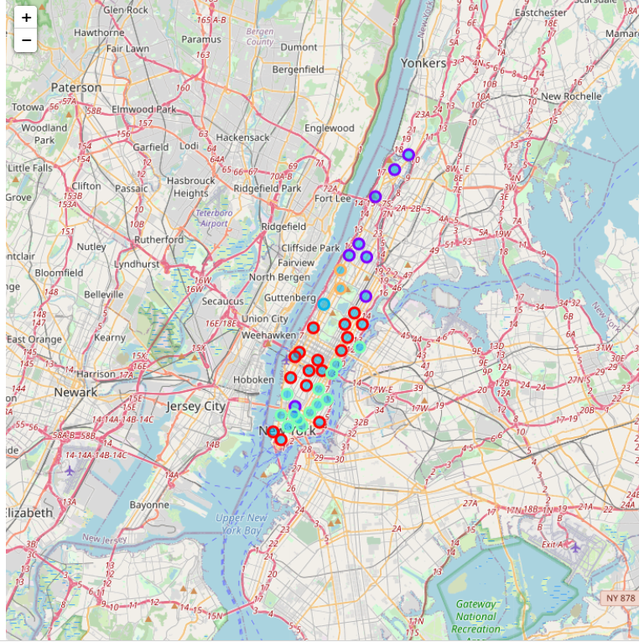
Presentation of the Problem
Capstone Project Pablo de la Fuente Aguilera
We cluster them into 5 groups and present it in a map with different colours
Clustering the Venues
The Battle of Neighborhoods
Week 1

Slide 7
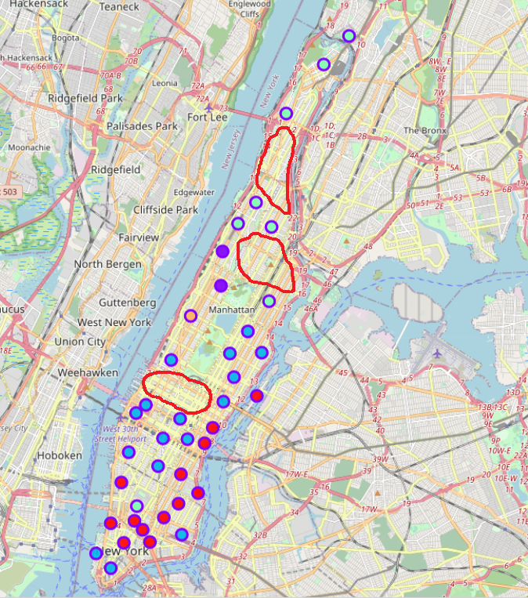
Presentation of the Problem
Capstone Project Pablo de la Fuente Aguilera
We find the best zones to open our restaurant and highlight them in red
Finding the best location
The Battle of Neighborhoods
Week 1

